Slide 1

UE19CS353 – Object Oriented Analysis and Design with Java
Theory ISA (Mini Project)
Presentation on
GAME BOX
By:
MANASI SWAIN– PES2UG19CS216
M SATVIKA– PES2UG19CS207
MEELA DEEPTI– PES2UG19CS227
6th Semester D
PES University, Bengaluru
(Established under Karnataka Act 16 of 2013)
Department of Computer Science & Engineering
Session: Jan - May 2022

Slide 2
Object Oriented Analysis and Design with Java (Mini Project)
Project Description
This project has 3 components
Login/registration
The Game Box-Here user has can choose between various games to play
Leader board-Present for every game and is accessed via mysql database
GitHub Link-https://github.com/manasiswain/game-box

Slide 3
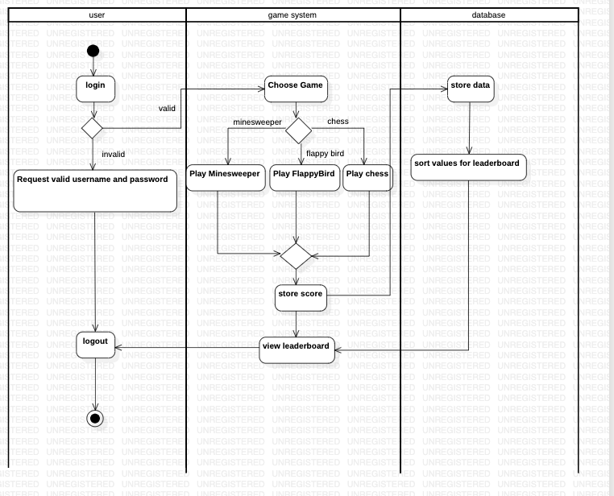
Object Oriented Analysis and Design with Java (Mini Project)
Analysis and Design Models
Activity Diagram for Game Box

Slide 4
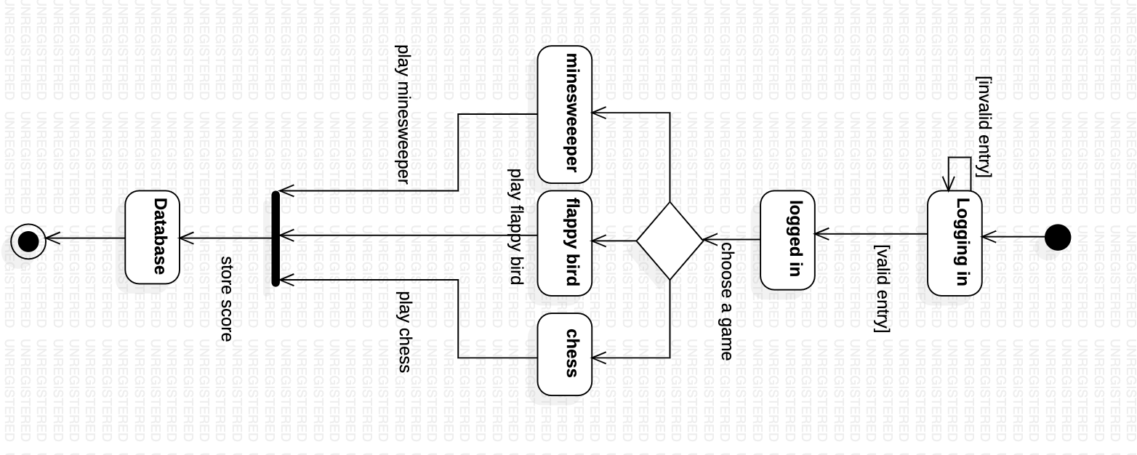
Object Oriented Analysis and Design with Java (Mini Project)
Analysis and Design Models
State Diagram for Game Box

Slide 5
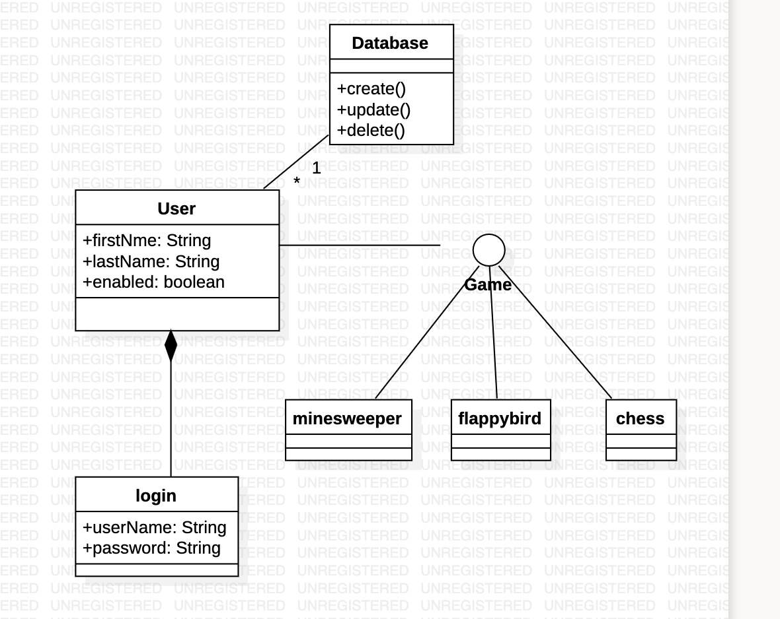
Object Oriented Analysis and Design with Java (Mini Project)
Analysis and Design Models
Class Diagram for Game Box

Slide 6
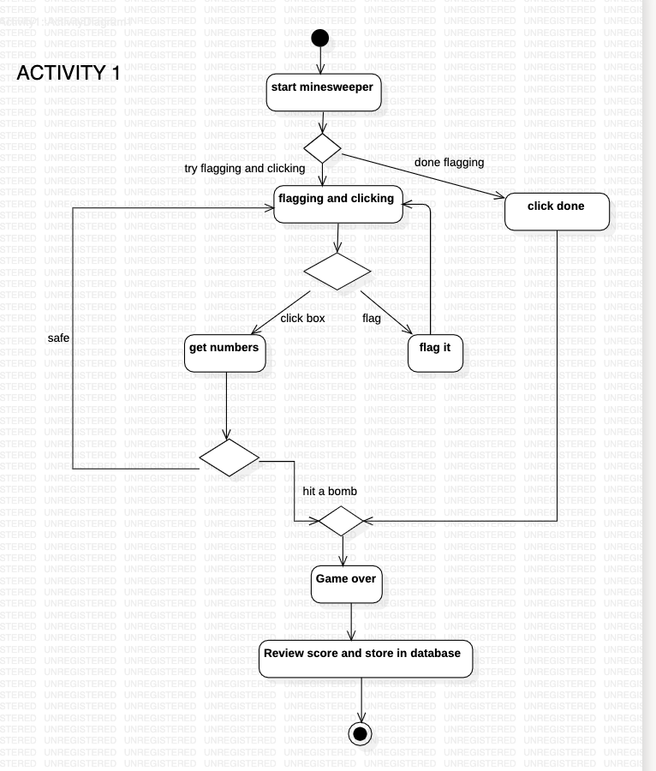
Object Oriented Analysis and Design with Java (Mini Project)
Analysis and Design Models
Activity Diagram for Minesweeper

Slide 7
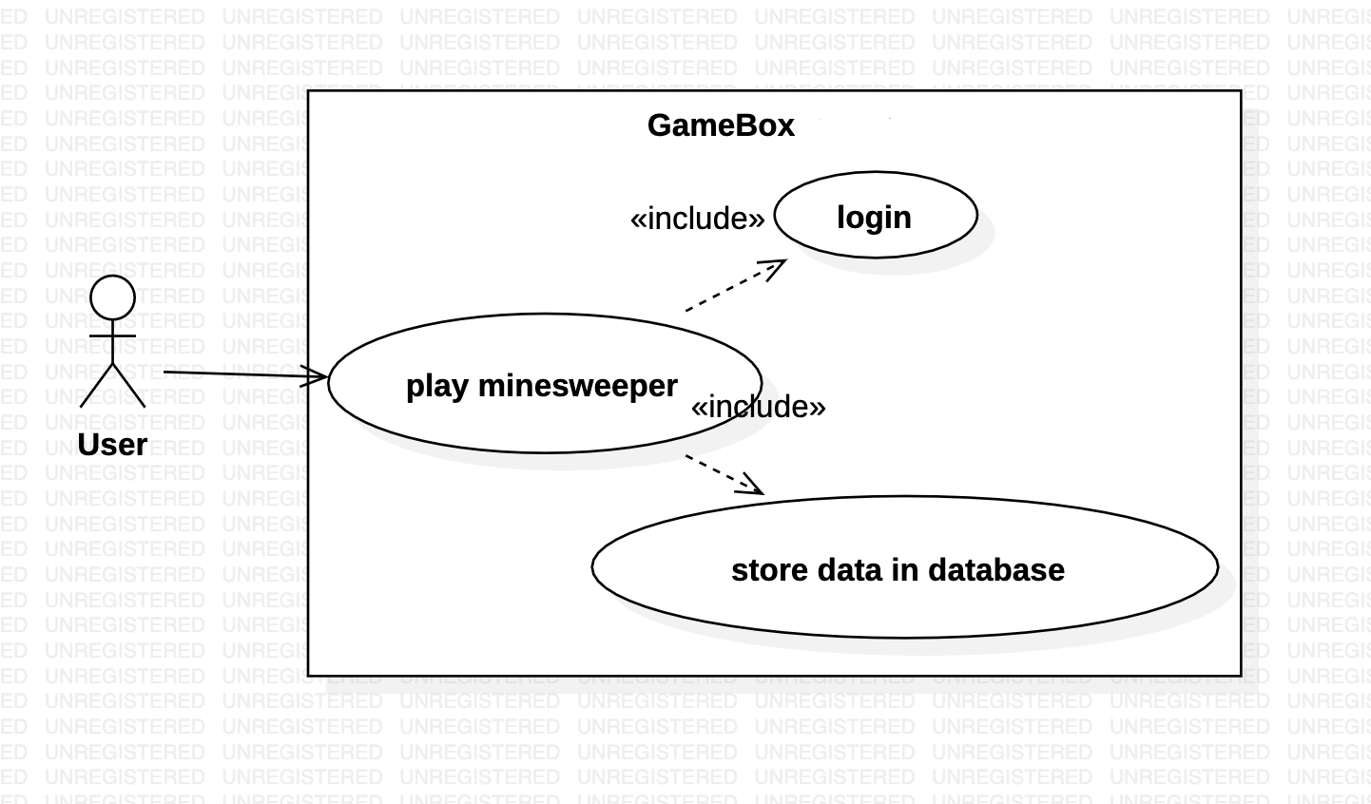
Object Oriented Analysis and Design with Java (Mini Project)
Analysis and Design Models
Use Case Diagram for minesweeper
external view

Slide 8
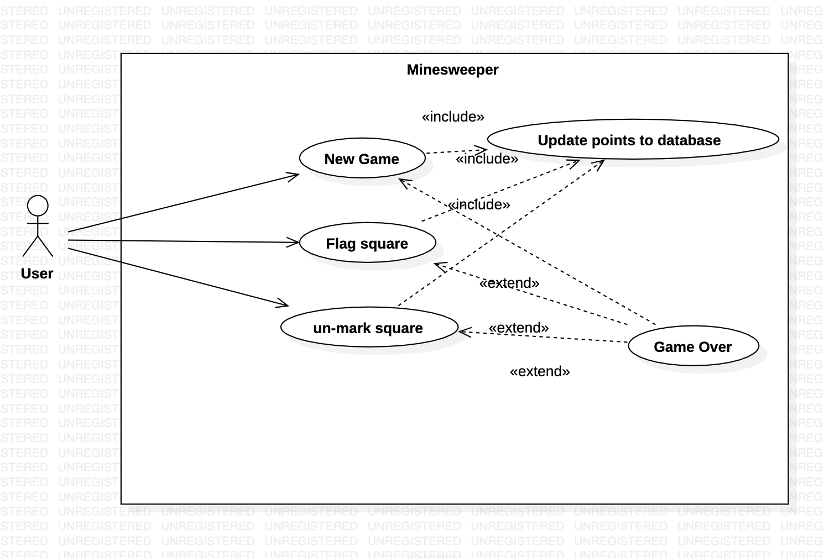
Object Oriented Analysis and Design with Java (Mini Project)
Analysis and Design Models
Use Case Diagram for minesweeper
internal view

Slide 9
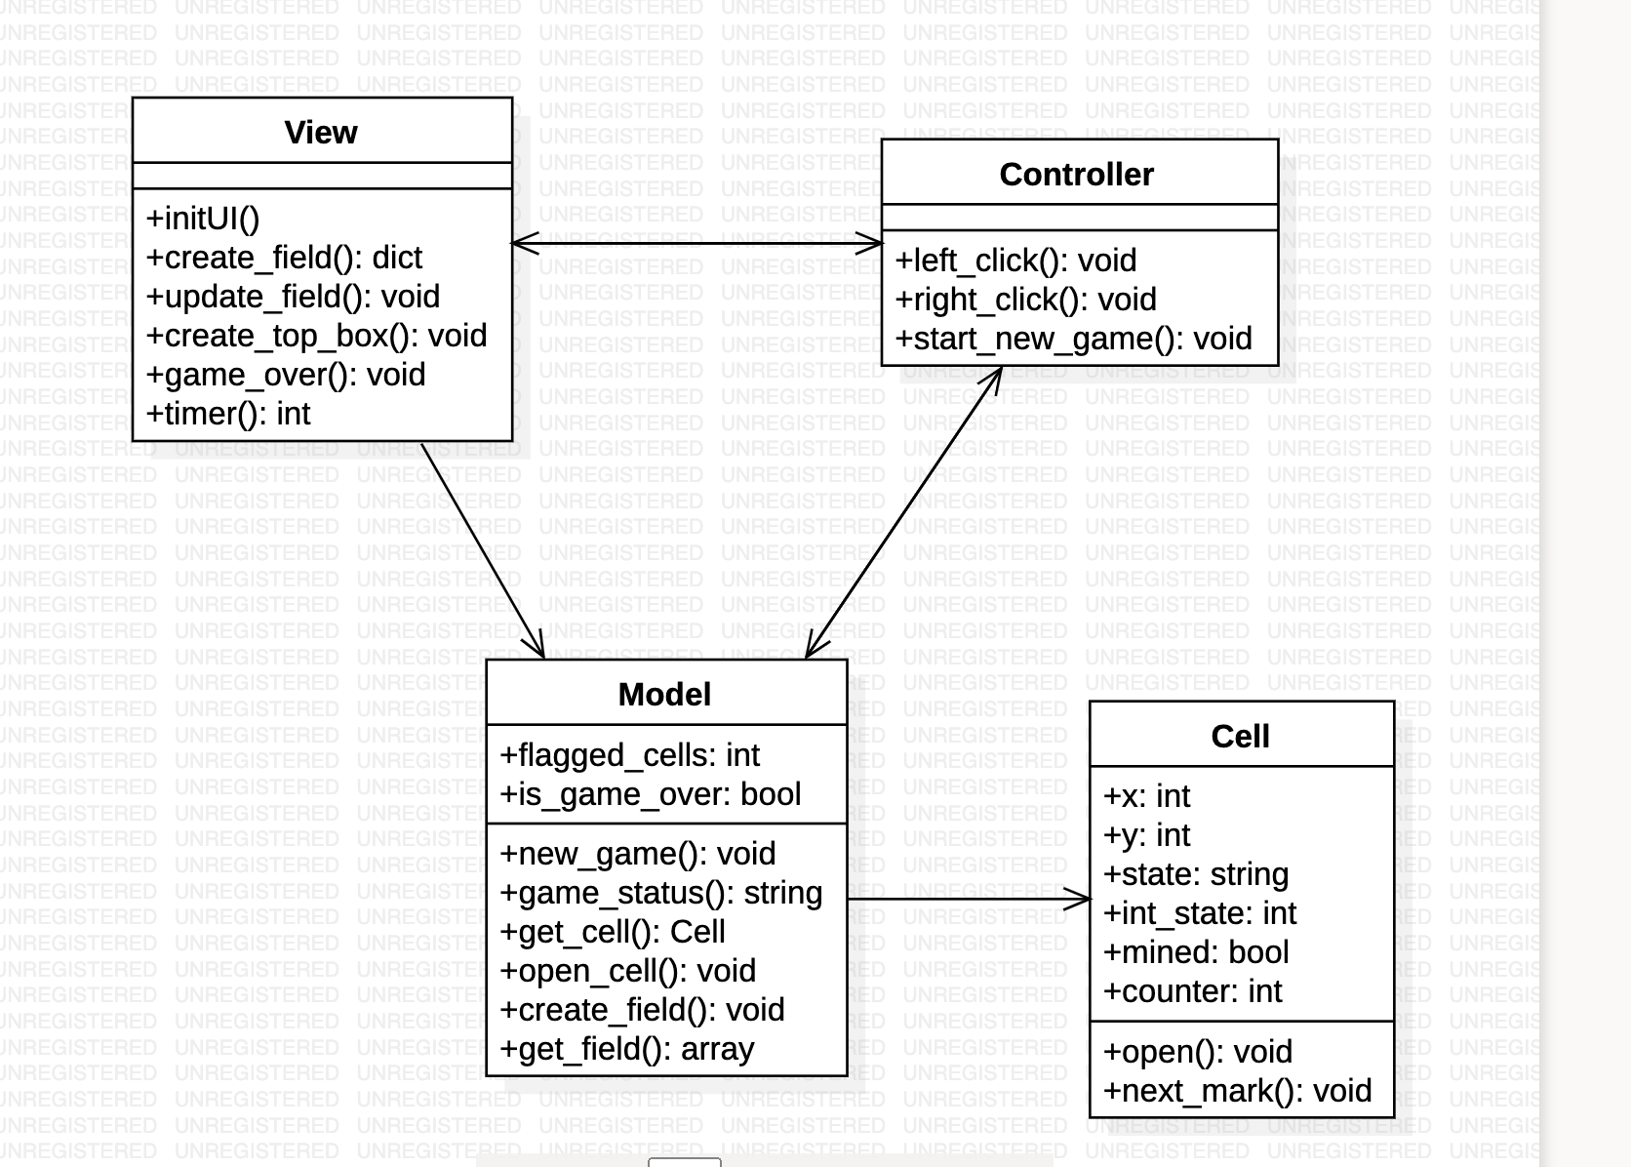
Object Oriented Analysis and Design with Java (Mini Project)
Analysis and Design Models
Class Diagram for minesweeper

Slide 10
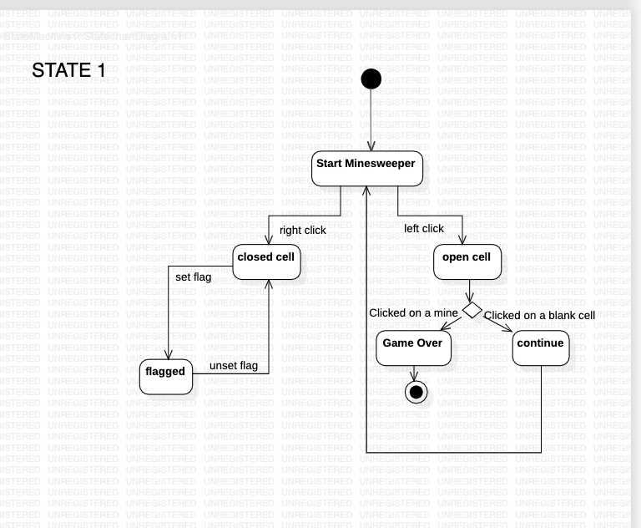
Object Oriented Analysis and Design with Java (Mini Project)
Analysis and Design Models
State Diagram for minesweeper

Slide 11
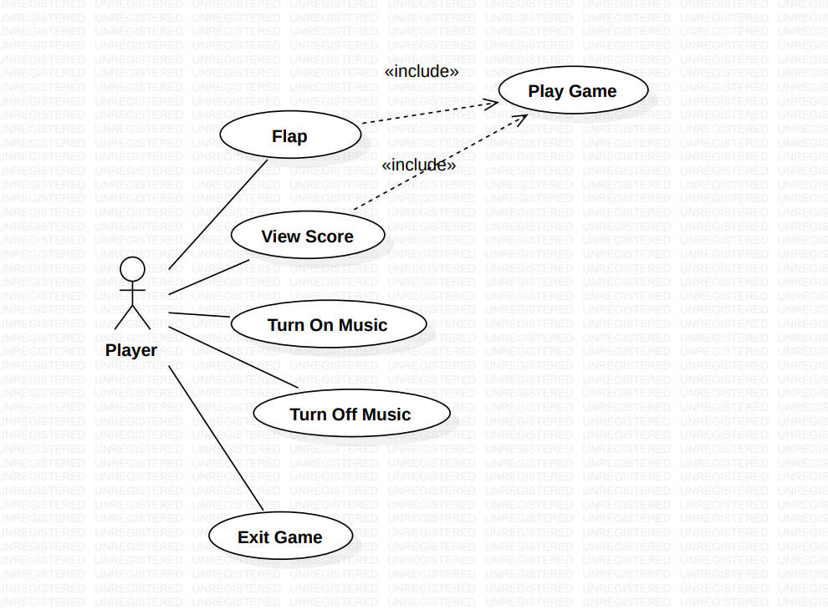
Object Oriented Analysis and Design with Java (Mini Project)
Analysis and Design Models
Use Case Diagram for FlappyBird

Slide 12
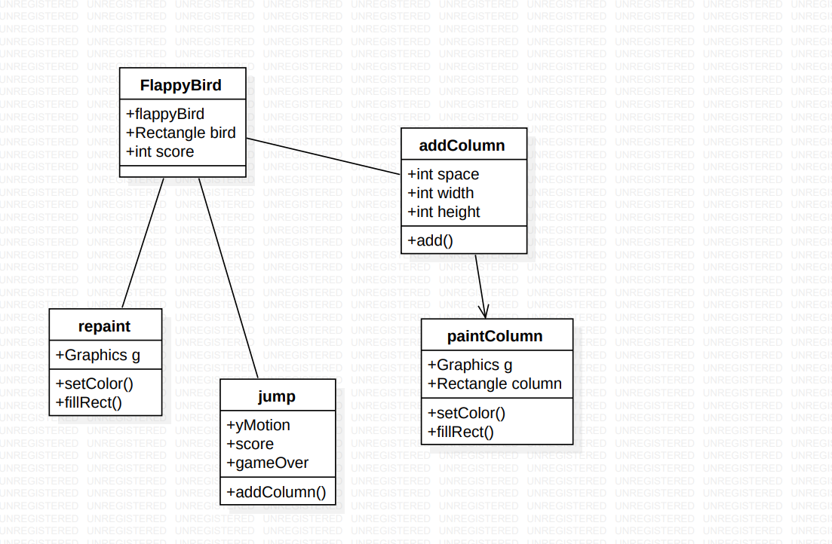
Object Oriented Analysis and Design with Java (Mini Project)
Analysis and Design Models
Class
Diagram for FlappyBird

Slide 13
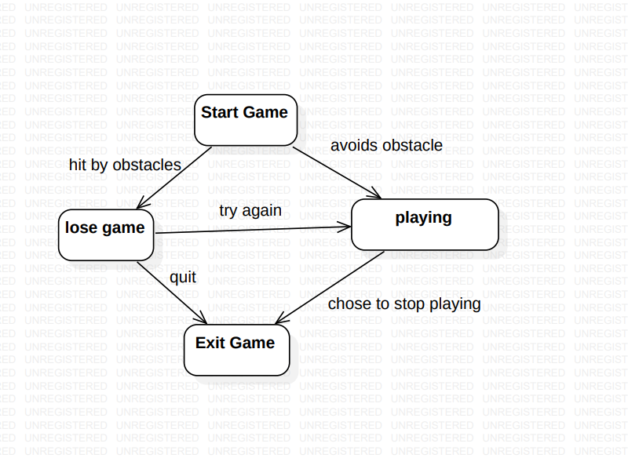
Object Oriented Analysis and Design with Java (Mini Project)
Analysis and Design Models
State Diagram for FlappyBird

Slide 14
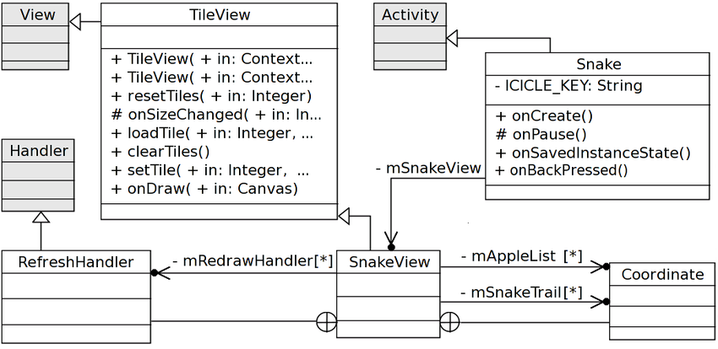
Object Oriented Analysis and Design with Java (Mini Project)
Analysis and Design Models
Class Diagram for Snake Game

Slide 15
Object Oriented Analysis and Design with Java (Mini Project)
Tools and Frameworks Used
Eclipse IDE
Java Swing
JDBC
MySQL Workbench

Slide 16
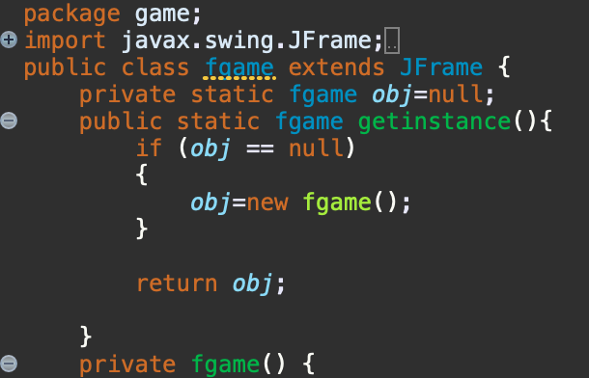
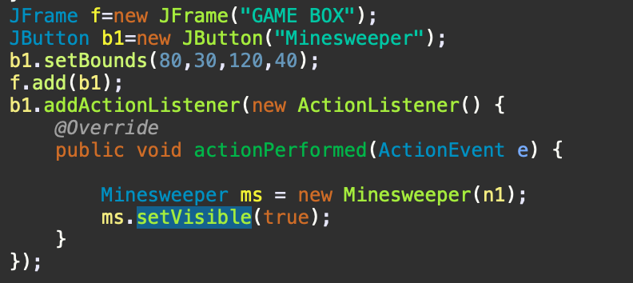
Object Oriented Analysis and Design with Java (Mini Project)
Design Principle and Design Patterns Applied
Singleton class
Used in:fgame class
Command pattern
Used in: Minesweeper class
The command pattern is a behavorial design
pattern in which an object is used to encapsulate
all information needed to perform an action or
trigger an event at a later time. All game specific
information is encapsulated there.
MVC design pattern
MVC design pattern is used using Java swing
M is the database schema
V is the UI
C is the fgame class that coordinates application

Slide 17
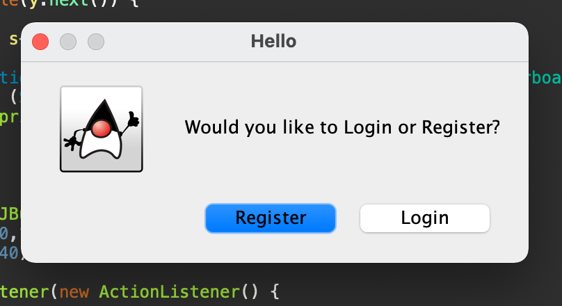
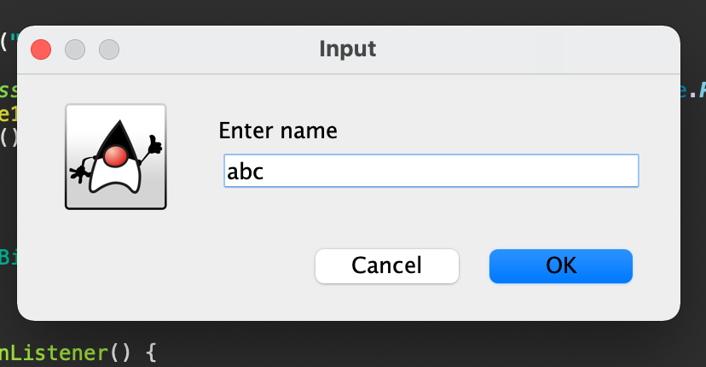
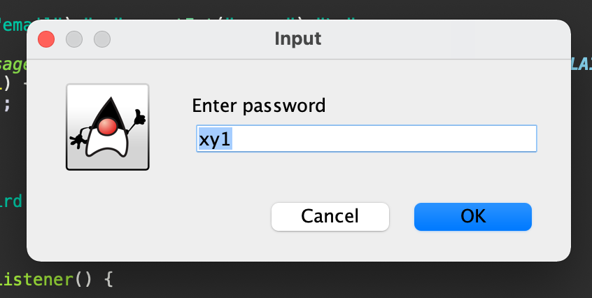
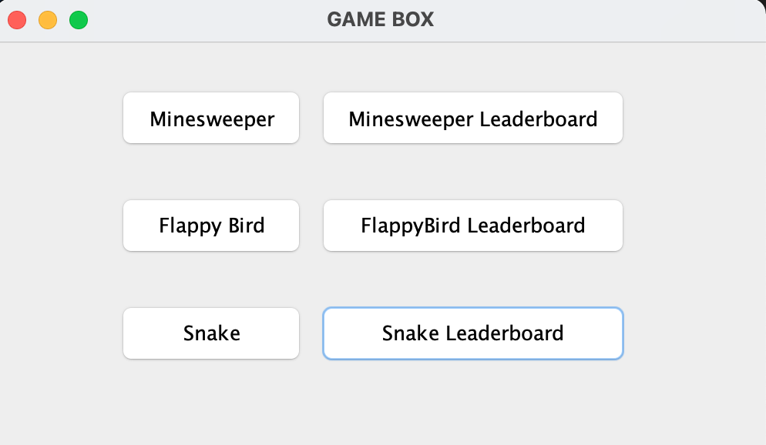
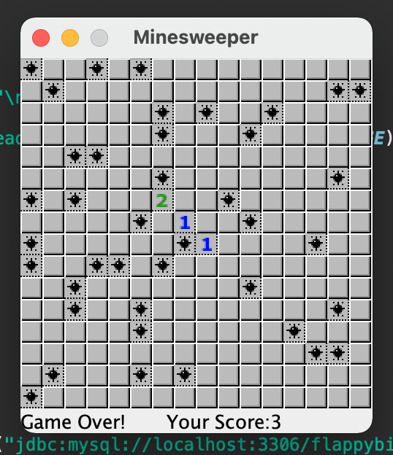
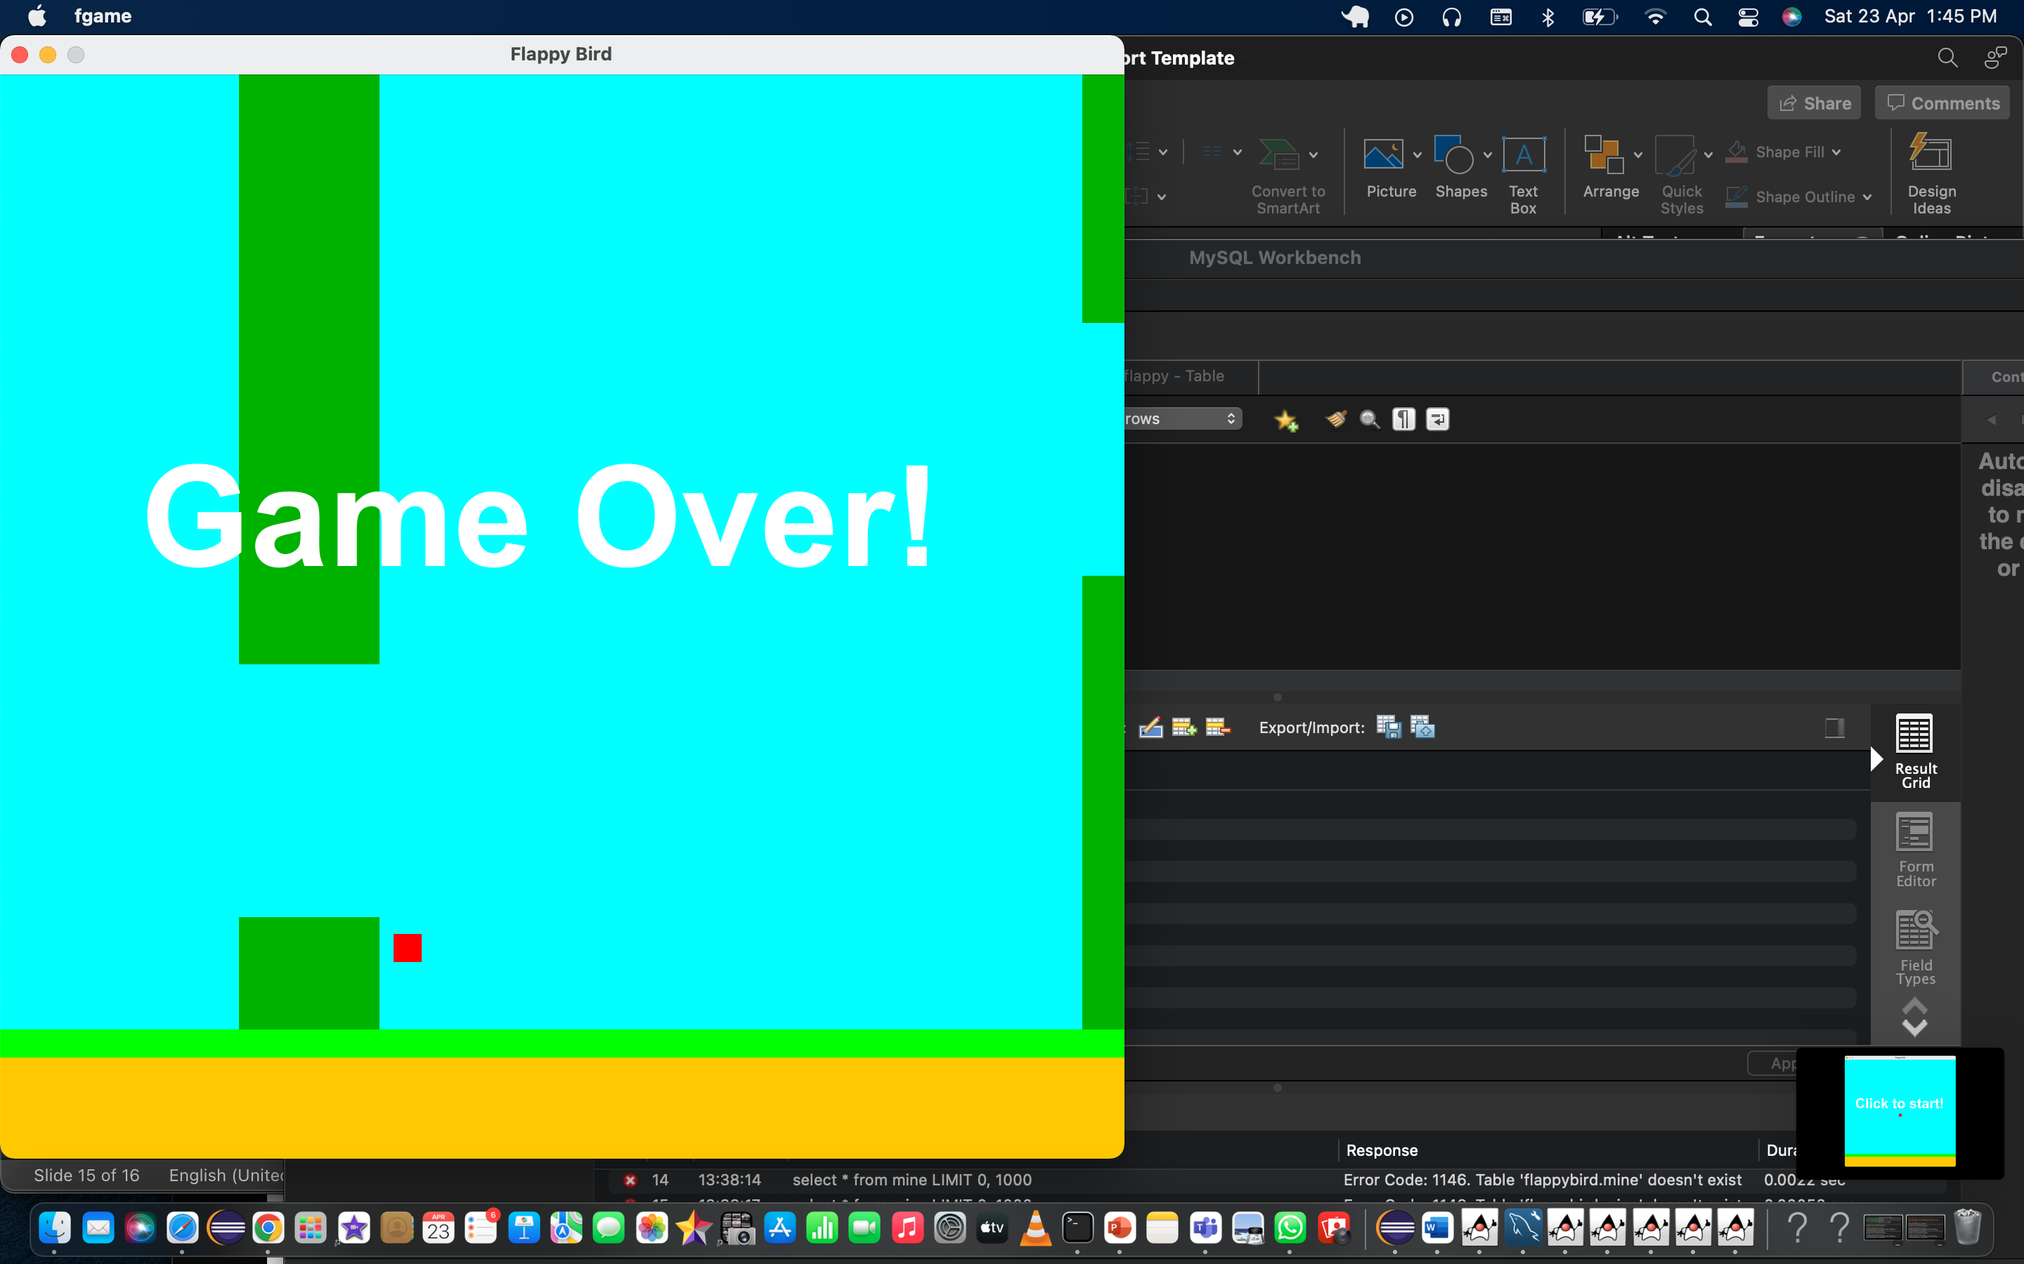
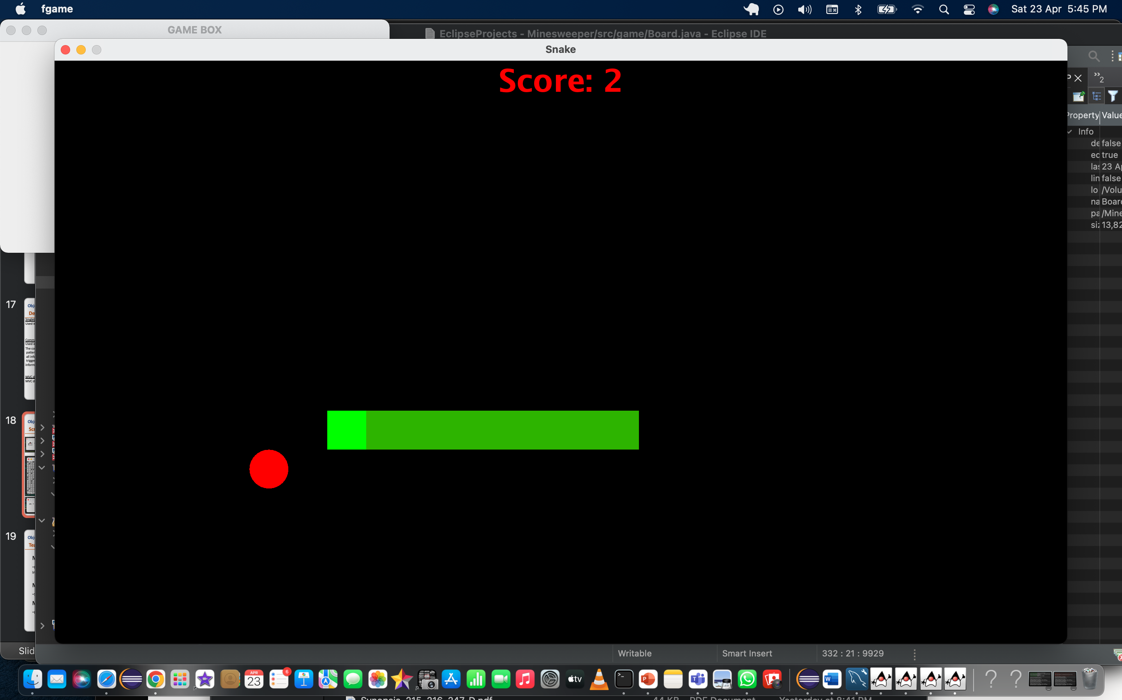
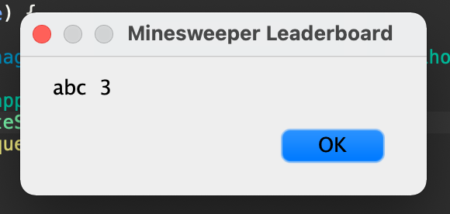
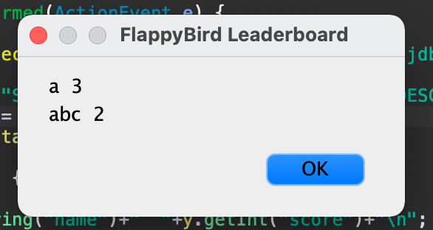
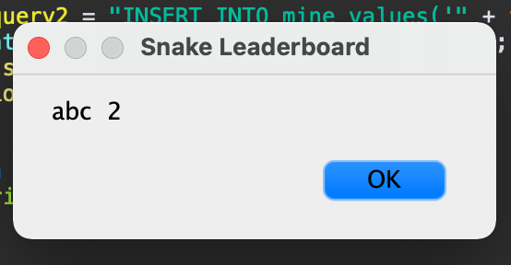
Object Oriented Analysis and Design with Java (Mini Project)
Screenshots

Slide 18
Object Oriented Analysis and Design with Java (Mini Project)
Team member contributions
Manasi Swain
-Minesweeper Game , Entire external system(login/register , Database Interaction, mvc)
Meela Deepti
-Snake Game
M Satvika
-Flappy Bird Game

